Slide 1
OpenCV Project
Made By:
Molnár Márk Krisztián
Péjó Kristóf
Gróf Richárd

Slide 2
Roles
File Reader:Péjó Kristóf
Number plate Reader Molnár Márk Krisztián
Colordetection: Gróf Richárd László

Slide 3

Project Manager tools
What we used for the group project was:
Trello
Github

Slide 4

The Program that we used for the Project
We used Pycharm for the project

Slide 5
Number Plate Reader
Made by Molnár Márk Krisztián

Slide 6
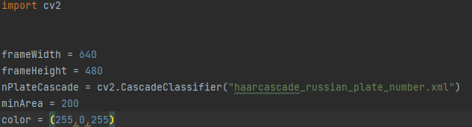
The Code’s structure
Import Libraries
Set the screensize
Load in the file
Set the detection area
And set the detection indicator color

Slide 7
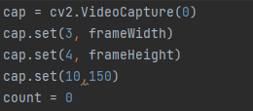
We set the programme to search number plates base on the camera’s picture
Setting the recording’s size.

Slide 8
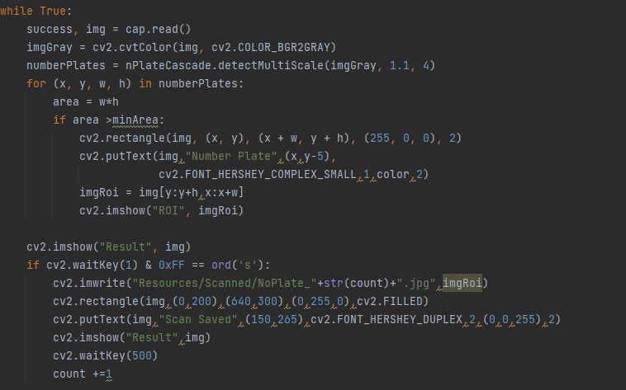
Reading the picture
Making a gray picture for the better detectability
Detecting number plate
Drawing a square around the number plate
Showing the numberplate in a different window

Slide 9
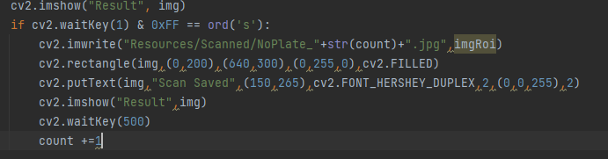
Showing the picture
Marks the number plate it’s detecting.
The square’s datas
It says that it could save the resault.
Shows the detected picture.

Slide 10
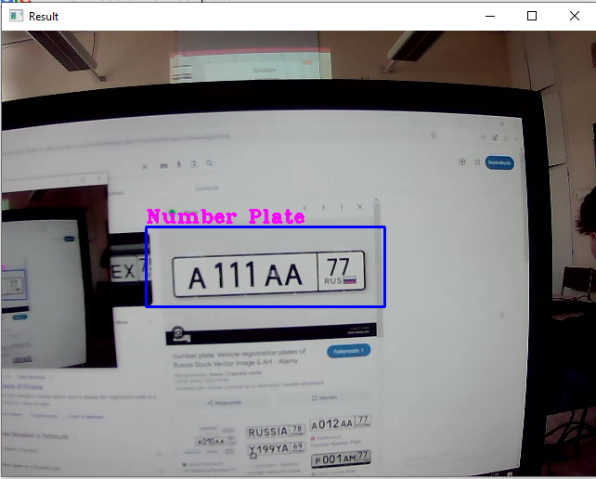
Testing the code
I tested the code by searching up some russian number plates and showed it to the camera.

Slide 11
Describeing the program
When we start the program a window pops up and it starts to search for a russian number plate.
When the camera detects a russian number plate it show you in a different window wich one did it find and saves it.
Fin.

Slide 12
File Reader
Made by: Péjó Kristóf

Slide 13
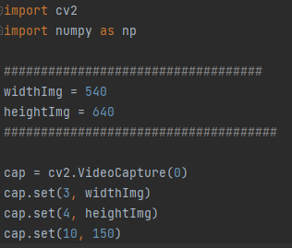
The Code’s structure
Import the cv2 and numpy directory
Save the width to variable (540) and height (640).
Opens the default camera.
Set the camera’s width and height
Set the Brightness of the camera(150).

Slide 14
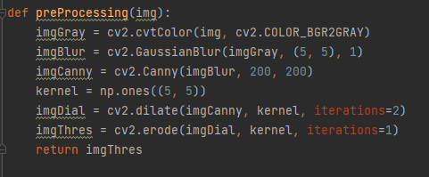
Convert the picture to gray
Use blur on the picture
Use Canny Edge filtering
Extend the edges
Use Erotion on the edges
Return the original picture

Slide 15
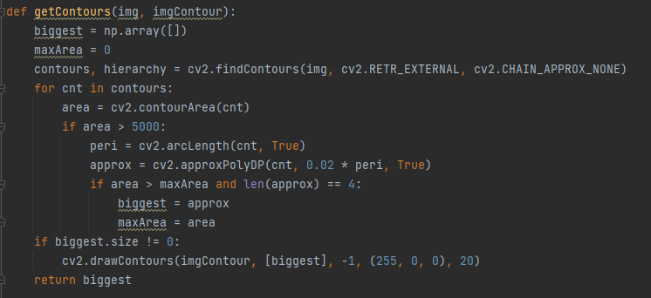
It calculates the contours. It checks the area of the contours. If the area is greater than 5000, it calculates the perimeter. If the contour consists of four sides and has the largest area, it stores it. If it finds the largest contour, it draws it. It returns the largest contour.

Slide 16
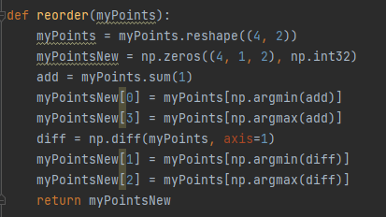
It converts the points into a 4x2 format.
It calculates the sum of the points and sorts them .
It determines the top-left and bottom-right points.
It calculates the difference between the points and sorts them.
It determines the top-right and bottom-left points.
It returns the newly sorted points.

Slide 17
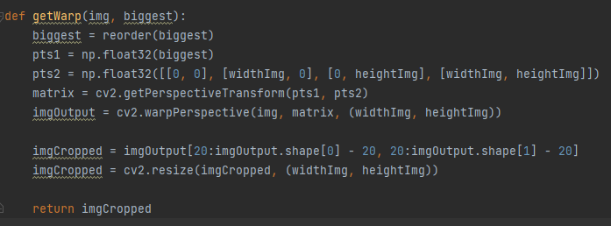
It sorts the contour points
It defines the source points (pts1) and the destination points (pts2).
It calculates the perspective transformation matrix.
It applies the transformation to the image.
It crops and resizes the image.
It returns the transformed and cropped image.

Slide 18
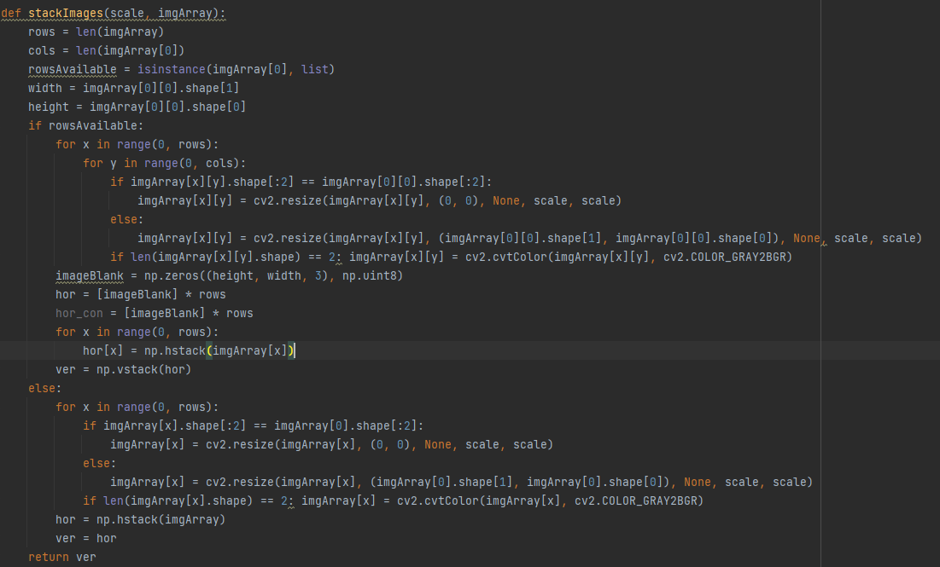
The function is capable of merging multiple images, resizing them, and stitching them together into one large image, taking into account their sizes and color channels.

Slide 19
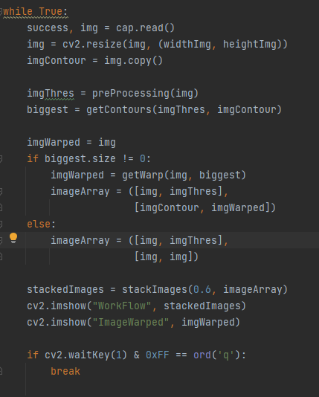
Reading a frame from the camera.
It resizes the image.
Performs preprocessing (preProcessing).
Calculates the contours (getContours).
If there is a valid contour, it performs the perspective transformation (getWarp).
Assembling and displaying the images.
The program stops when the 'q' key is pressed.

Slide 20
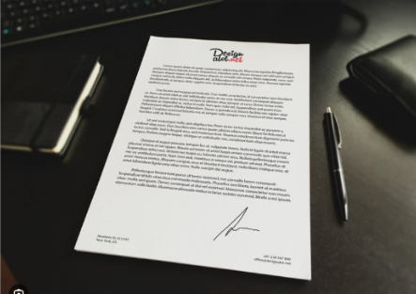
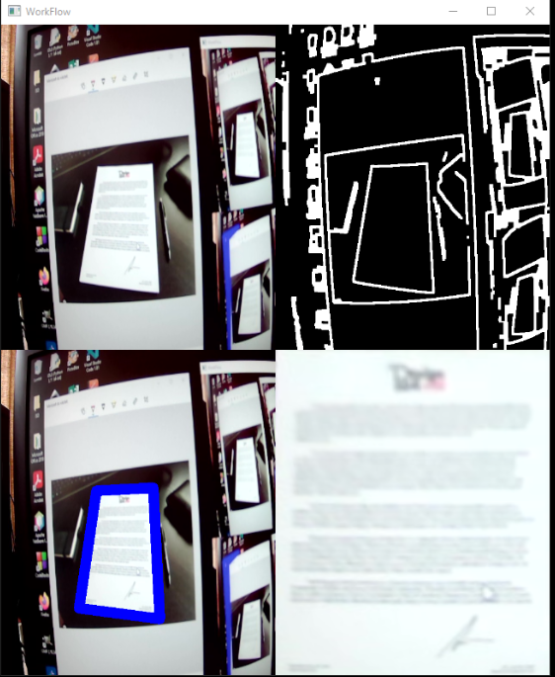
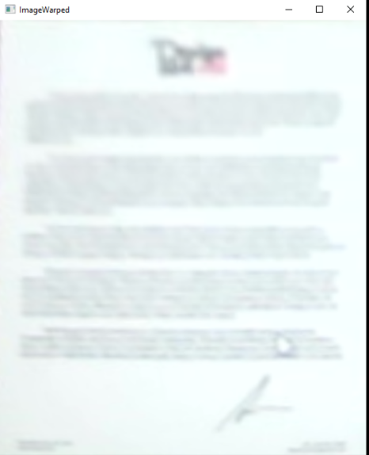
Testing and demonstrating the code

Slide 21
Display drawing, color detection
Mady by :Gróf Richárd

Slide 22
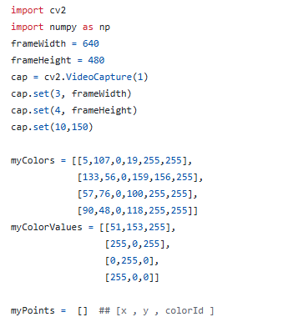
The Code’s structure
You can see all the imported directorys and variables

Slide 23
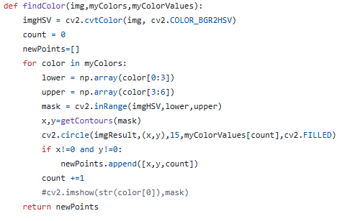
The Code’s structure
This is where de program detects the colors.

Slide 24
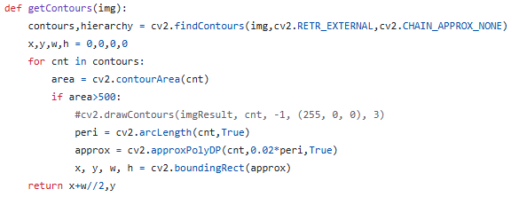
The Code’s structure
We can see our contours.

Slide 25
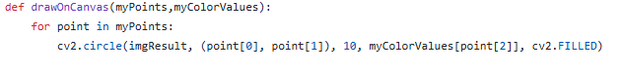
The Code’s structure
This part of the code is showing the drawing.

Slide 26
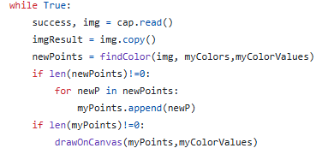
The Code’s structure
This part of the code shows the drawing on the display.

Slide 27
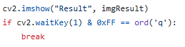
The Code’s structure
Than we show it.

Slide 28
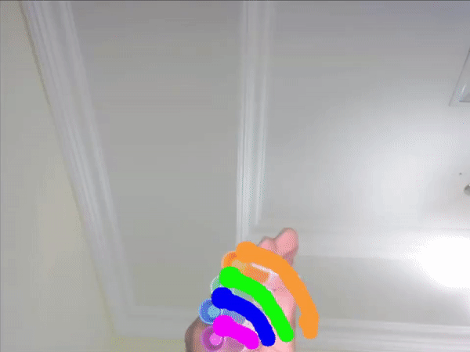
The Code’s test
Now we test it, with the specific colors that we need.

Slide 29
Describeing the program
When you start the program, the camera’s picture is appaers. If you are showing a stuff that has the specific color, then you can draw with that color on the display.

Slide 30
The End
Thanks for your listening! Made By: Molnár Márk, Péjó Kristóf, Gróf Richárd

